Slide 1
PHISHING ATTACK DETECTION USING MACHINE LEARNING ALGORITHMS
Team Details :
RAYASAM DIVIJA (20EG105439)
VADDE MAHESH REDDY (20EG105448)
ENUGALA VISHNU VARDHAN REDDY (20EG105720)
Project Supervisor
Name: T. Srikanth
Designation: Assistant Professor Dept of CSE

Slide 2

Introduction
Phishing is a Cyber Attack where deceptive emails or messages that mimic reputable sources, aiming to trick recipients into revealing personal information by clicking malicious links.
This project addresses phishing attack detection using hybrid machine learning techniques including Random Forest, Gradient Boosting,
Logistic Regression and SVM.
Focused on Email and SMS phishing, the system analyzes patterns to proactively identify threats and calculates a risk factor for incoming messages.
It has applications like Enterprise email security, Telecommunications, Government, Health care and many more…

Slide 3
Problem Statement:
To Design a machine learning-based model using Algorithms to detect phishing attacks in Emails, safeguarding users and organizations against fraudulent attempts to acquire sensitive data.

Slide 4
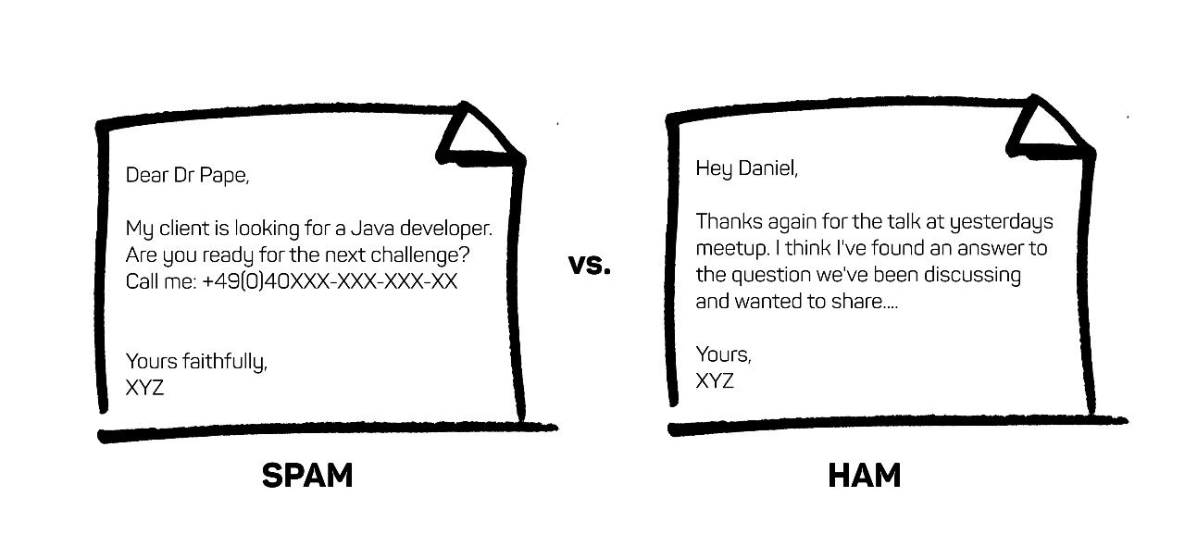
ILLUSTRATE OF THE PROBLEM
Phishing attacks are the practice of sending fraudulent communications that appear to come from a reputable source. It is usually done through email. The goal is to steal sensitive data like credit card and login information, or to install.
In today's digital world, phishing attacks via emails continue to be a prevalent and deceptive threat. Phishing attacks involve the creation of deceptive emails that appear to be from legitimate sources, aimed at tricking recipients into divulging sensitive information or engaging in malicious activities. These emails often lead to significant security breaches, data theft, and financial losses. Safeguarding users and organizations against such fraudulent attempts is of paramount importance.

Slide 5
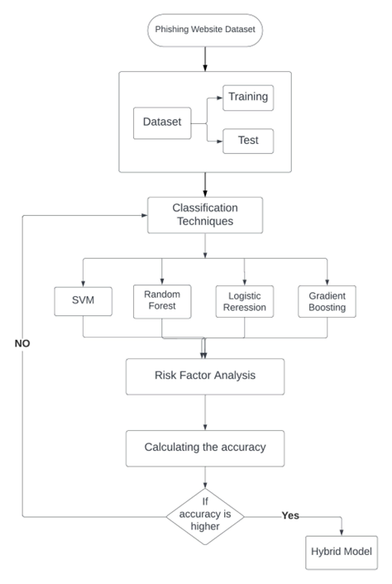
Proposed Method
Training Phase:
The training phase aims to build machine learning models that can differentiate between legitimate and phishing messages.
Data Collection:
Gathering a labeled dataset of Email and SMS messages. This dataset is taken from the Kaggle which contains both spam and legitimate messages.
Features Extraction:
We will convert the raw email or SMS data into numerical features that numerical algorithms can work with, TF - IDF (Term Frequency - Inverse Document Frequency), Word Embeddings.
Feature Selection:
Selecting the methods to reduce dimensionality and improve model performance. Feature selection methods like feature importance from Random Forest and Gradient Boosting, Recursive Feature Elimination (RFE) and Regularization.

Slide 6
Proposed Method
Model Selection:
Selecting a Hybrid approach combing the algorithms Random Forest + Gradient Boosting + Logistic Regression + SVM Model.
Training:
Each algorithm (Random Forest, Gradient Boosting, Logistic Regression, and Support Vector Machine) is trained separately using a labeled dataset.
The algorithms learn from the data and aim to create models that can predict whether a given message is legitimate (0) or phishing (1) which is weighted voting and we also use stacking.
Model Evaluation:
Evaluating the model on a validated dataset, using metrics such as accuracy, precision, recall, F1-score.

Slide 7

Proposed Method
Risk Analysis Phase:
The Risk Analysis phase focuses on assessing the risk associated with incoming email and SMS messages risk factors are assessed for each message. These risk factors can include features like sender domain mismatches, suspicious keywords, or unusual URL patterns.
Then we classify it as legitimate or spam based on the identified risk factors, each message is assigned a risk score. Risk scores are numerical values that reflect the level of suspicion associated with a message. depending on that the system takes actions such as blocking or alerting users or administrators.
The data is then tested and deployed.
The system is continuously monitored to update if anything needed

Slide 8
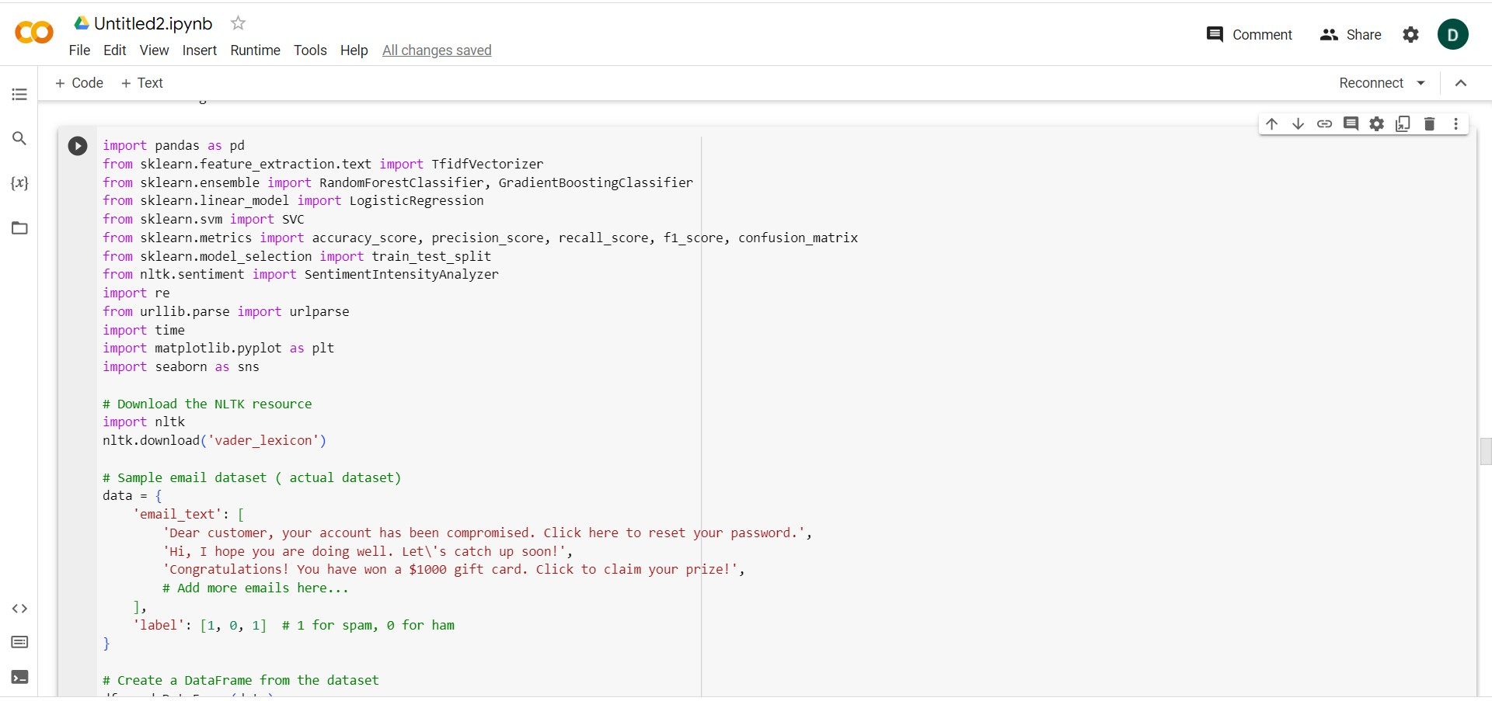
Experiment Environment
Environment used is GOOGLE COLAB
Using python language

Slide 9
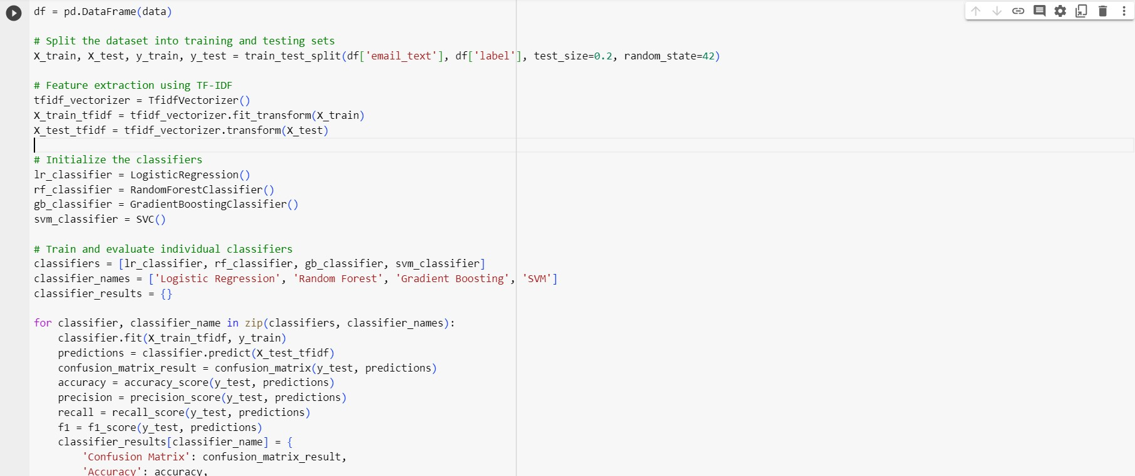
Experiment Screen shorts

Slide 10
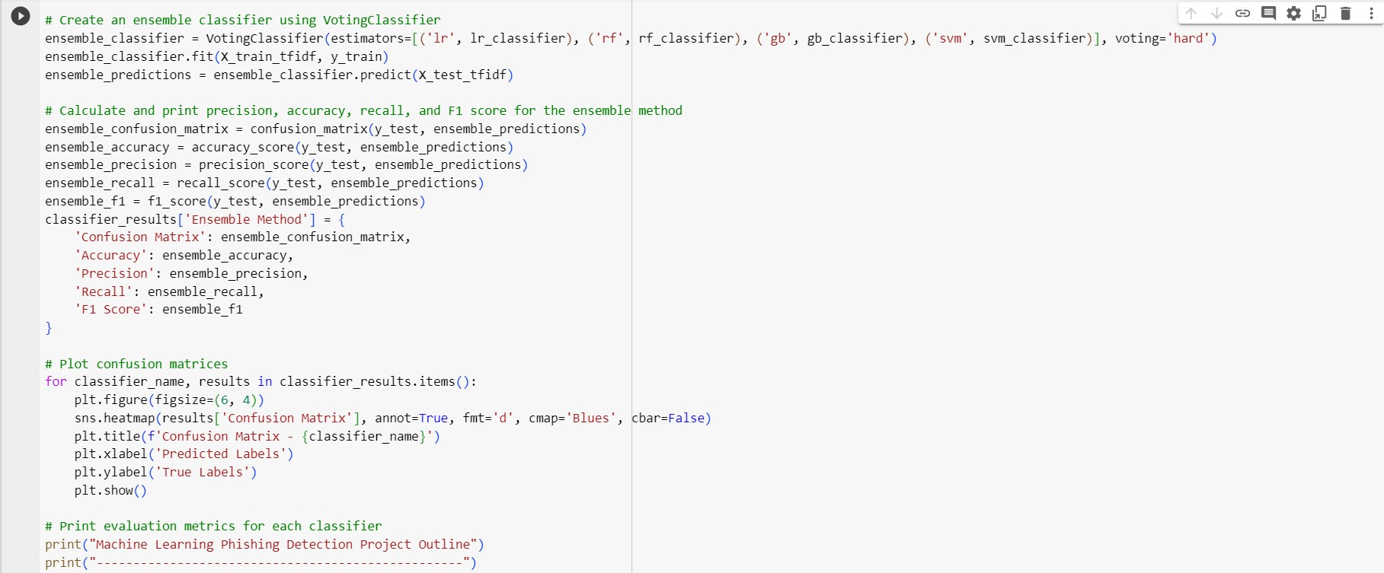
Experiment Screen shorts

Slide 11
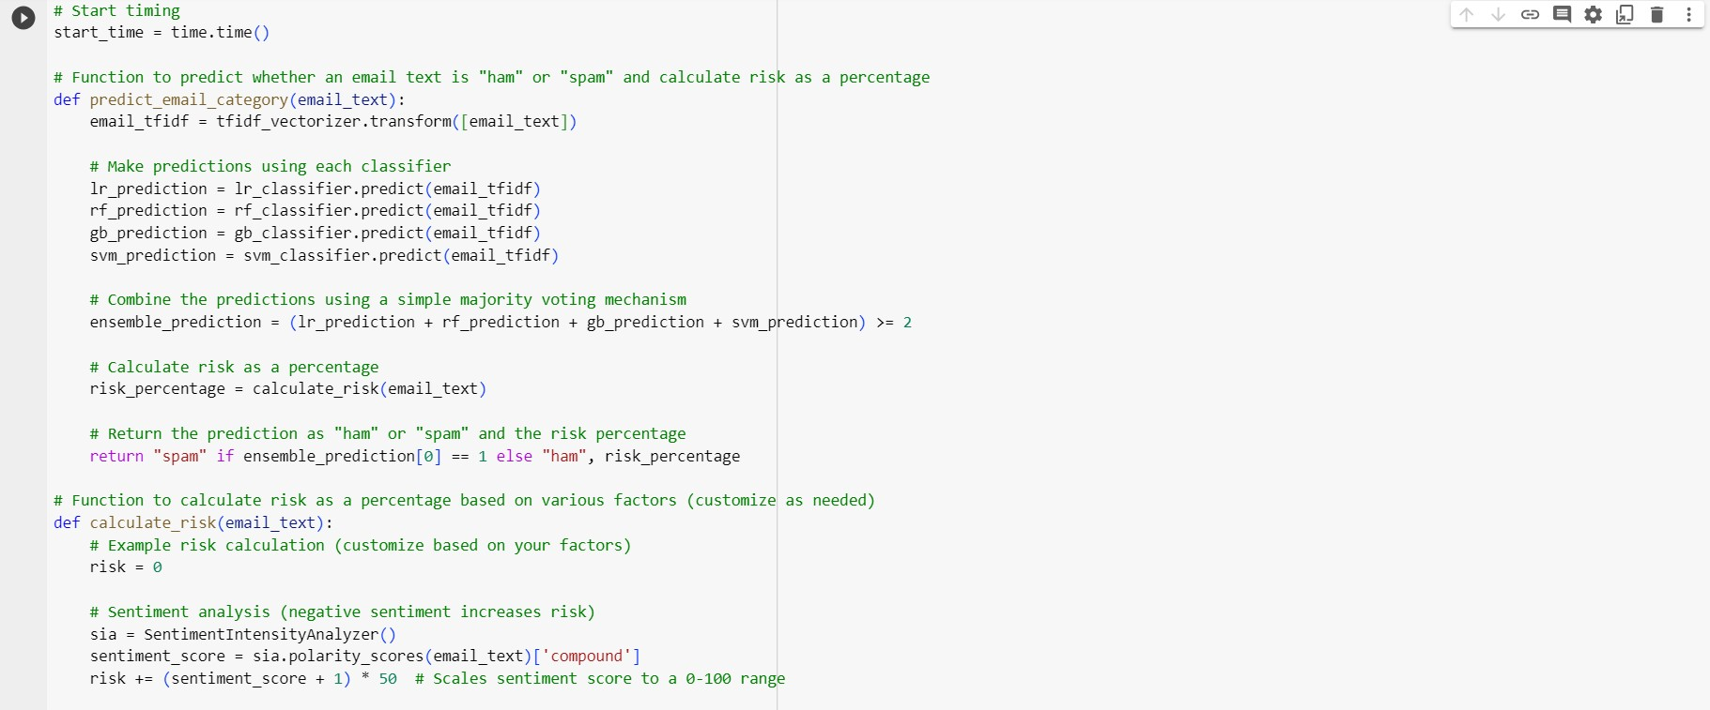
Experiment Screen shorts

Slide 12
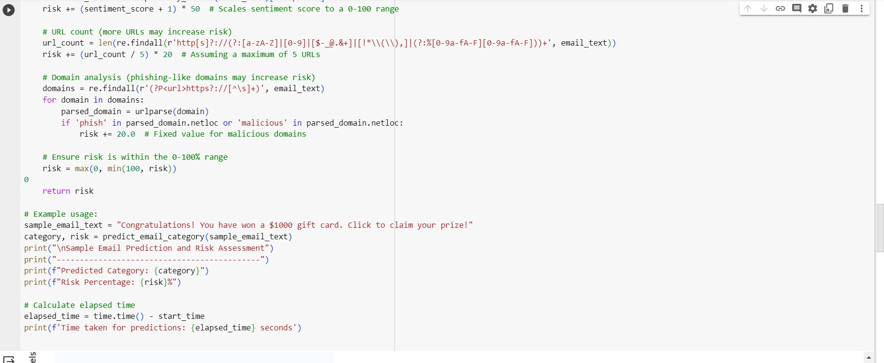
Experiment Screen shorts

Slide 13
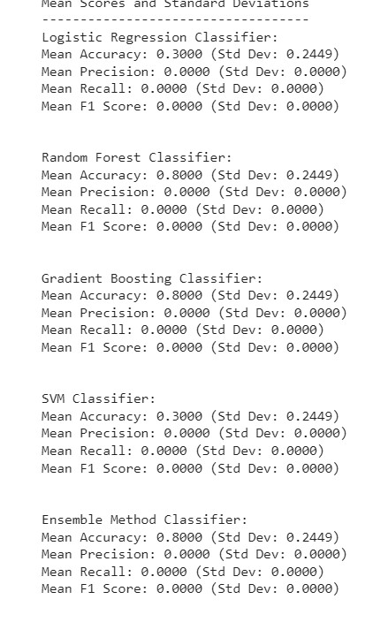
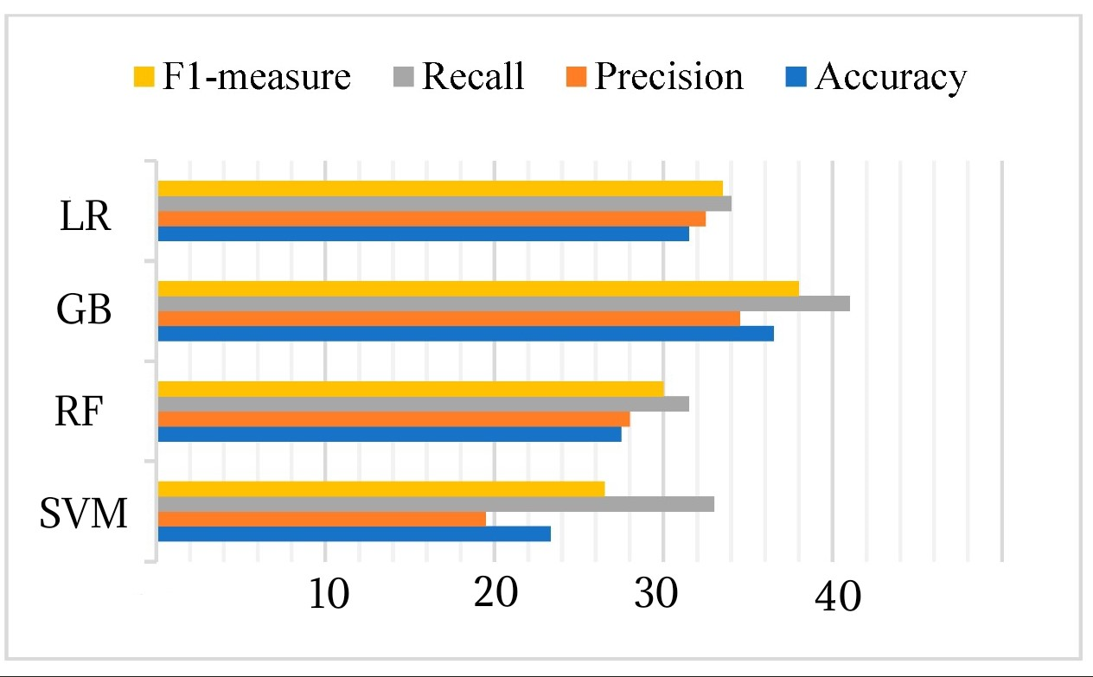
Experiment Results

Slide 14
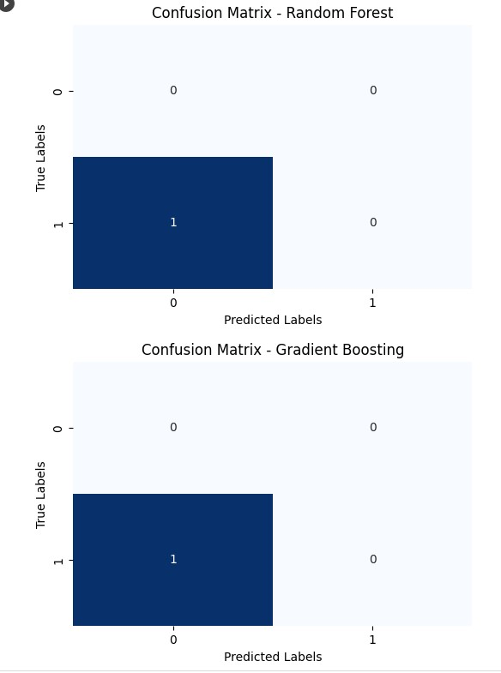
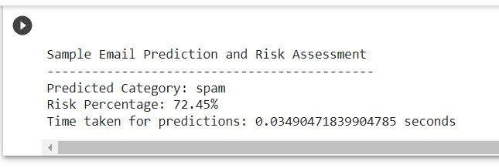
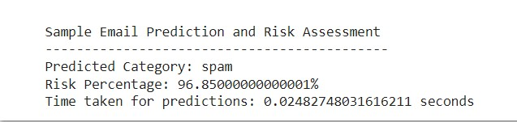
Experiment Results

Slide 15
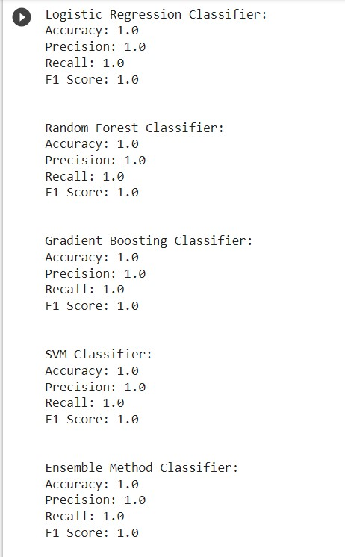
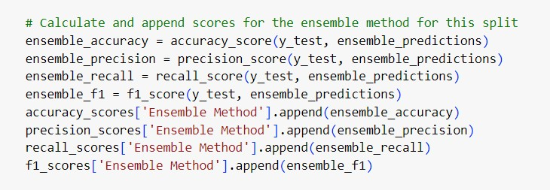
Experiment Results

Slide 16
Experiment Results
Input Mails | Predicted Category | Risk Percentage | Time Taken
"Congratulations! You have won a $1000 gift card. Click to claim your prize!" | Spam | 96.85000000001% | 0.02482748316 sec
"Congratulations! you got a new car collect your gift by calling to this number" | Spam | 85.405% | 0.121652364730 sec
'urgent! pay $2000 to not suspend your account. | Spam | 72.45% | 0.034904718399 sec
security alert! suspicious activity $1000 from your friend. Click to see! | Spam | 97.200000000% | 0.025539915771 sec

Slide 17
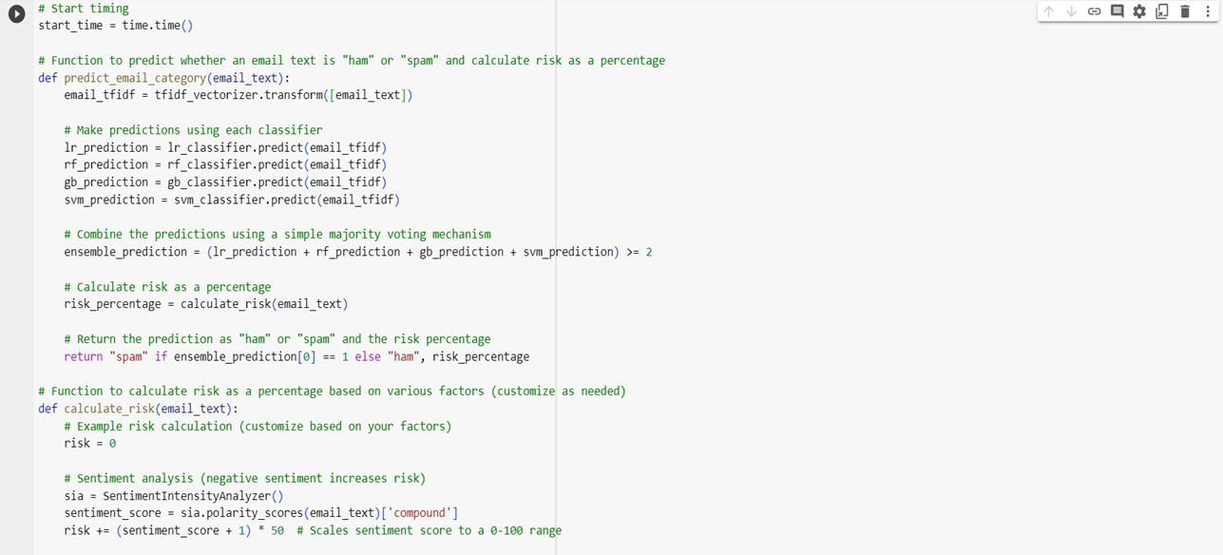
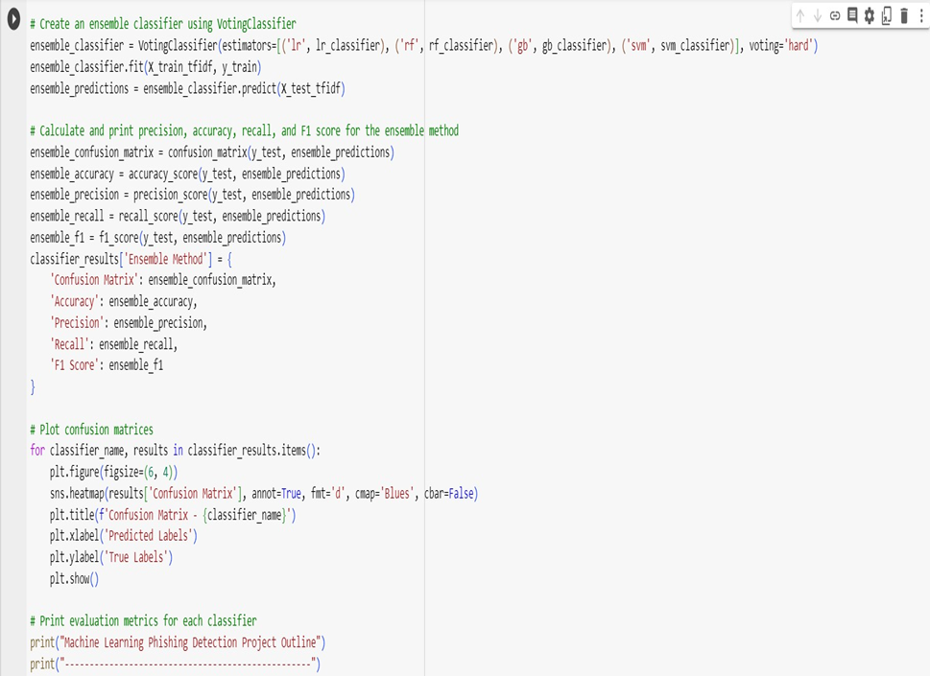
Risk calculating algorithm
Ensemble method algorithm

Slide 18
Findings
Starting this project evaluates the performance of various machine learning algorithms, including Logistic Regression, Random Forest, Gradient Boosting, and SVM, improved using metrics like accuracy, precision, recall, and F1-score.An ensemble approach is employed, combining the strengths of multiple classifiers.
Provided the data as real time and then Feature extraction is based on TF-IDF, which is suitable for converting text data into numerical features.
Risk assessment, a critical output, is calculated based on sentiment, URL count, and domain analysis, with recommendations to include additional risk factors calculating the risk percentage.

Slide 19
Justification
The parameters we have improved by the proposed system are
1.Risk percentage calculation
2.Mean Accuracy
3. Mean precision
We have calculated Risk percentage using
risk += (sentiment_score + 1) * 50
len(re.findall()), risk += (url_count / 5) * 20
max(0, min(100, risk))
The ensemble method we developed helps to improve prediction of both spam and ham mails with Hybrid approach it increased the approach compared to previous methods.

